Slide 1
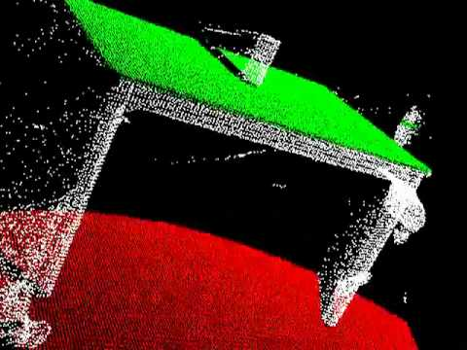

Curve fitting
Yoni Chechik
www.AIisMath.com

Slide 2
References
http://szeliski.org/Book/
http://www.cs.cornell.edu/courses/cs5670/2019sp/lectures/lectures.html
http://www.cs.cmu.edu/~16385/

Slide 3
TOC
Least squares
Total least squares
RANSAC

Slide 4
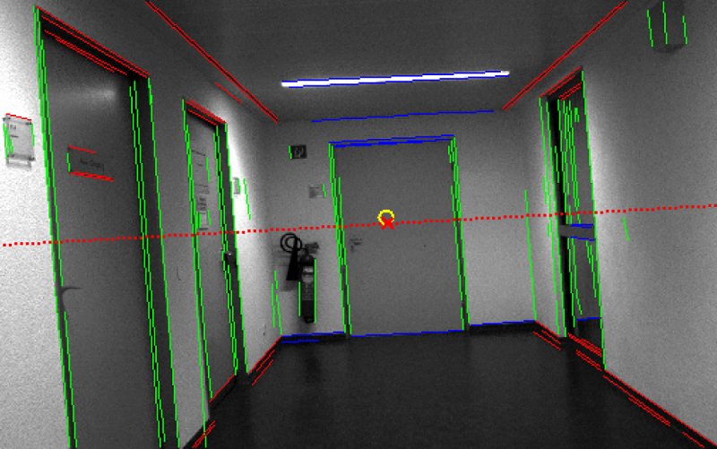
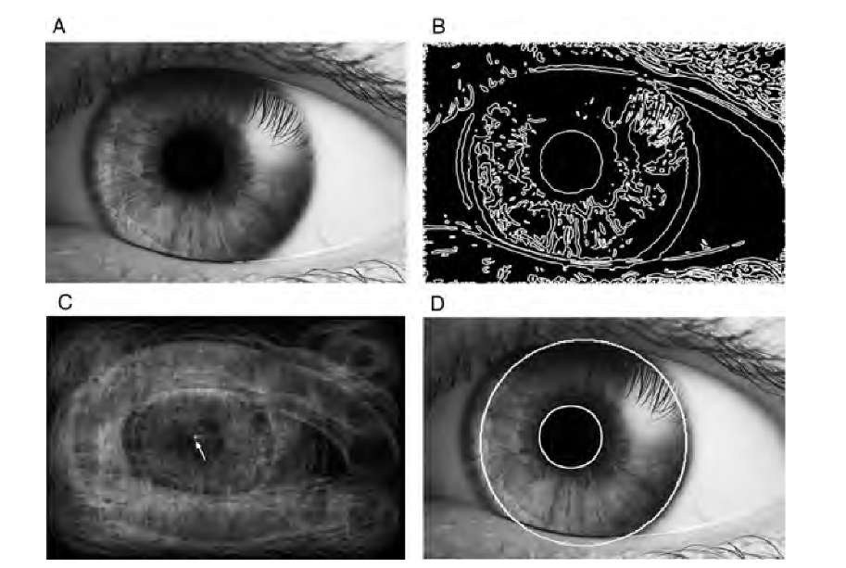
Some motivation
Autonomous Vehicles
(lane line detection)
Bio-medical engineering
(blood vessel counting)
Biology
(earthworm contours)
Robotics
(scene understanding)
Psychology/ Human computer interaction
(eye tracking)

Slide 5
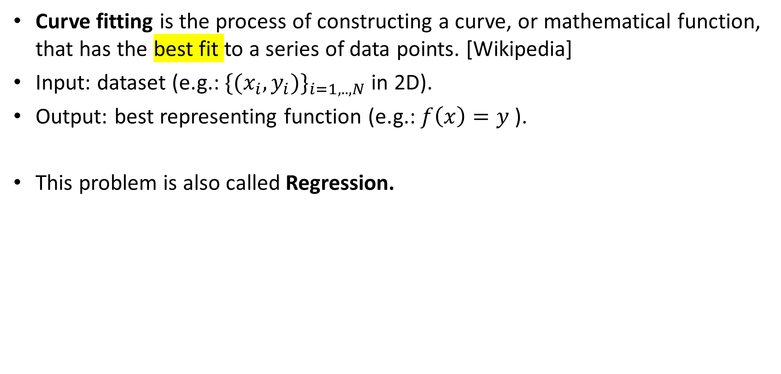
What is curve fitting
Curve fitting is the process of constructing a curve, or mathematical function, that has the best fit to a series of data points. [Wikipedia]
Input: dataset (e.g.: ${\{(x_{i},y_{i})\}}_{i=1,..,N}$in 2D).
Output: best representing function (e.g.: $f\left(x\right)=y$ ).
This problem is also called Regression.

Slide 6
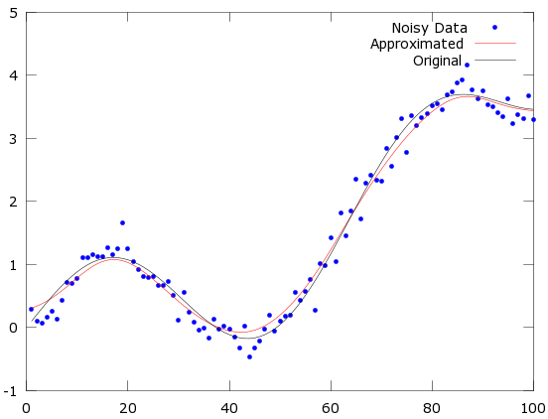
Best fit
The best fit is the one which minimizes the error of the fitted function relative to the given data.

Slide 7
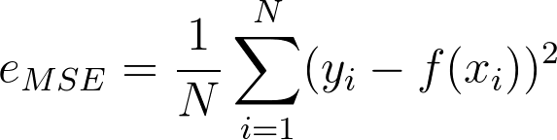
Error / Loss
Error (also known as loss) is a method of evaluating how well a specific algorithm models the given data.
If predictions deviates too much from actual results, error would be high.
A popular error used a lot in CV and statistics is called MSE (mean square error, also known as L2 loss or quadratic loss).
MSE: The mean of the distance from each point to the predicted regression model.
We need to find the set of variables that minimizes the error - MMSE (minimum mean square error).
Other variants of this error are SSD (sum of square distances) or RMSE (root mean square error)

Slide 8
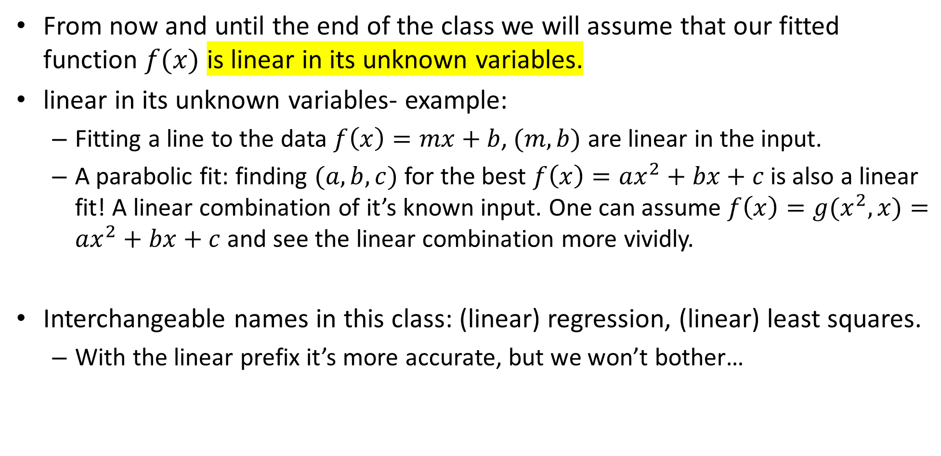
Linearity assumption
From now and until the end of the class we will assume that our fitted function $f(x)$ is linear in its unknown variables.
linear in its unknown variables- example:
Fitting a line to the data $f\left(x\right)=mx+b$, $(m,b)$ are linear in the input.
A parabolic fit: finding $(a,b,c)$ for the best $f\left(x\right)=ax^{2}+bx+c$is also a linear fit! A linear combination of it’s known input. One can assume $f\left(x\right)=g(x^{2},x)=ax^{2}+bx+c$and see the linear combination more vividly.
Interchangeable names in this class: (linear) regression, (linear) least squares.
With the linear prefix it’s more accurate, but we won’t bother…

Slide 9
Linearity assumption
What is not linear in its unknown variables?

Slide 10
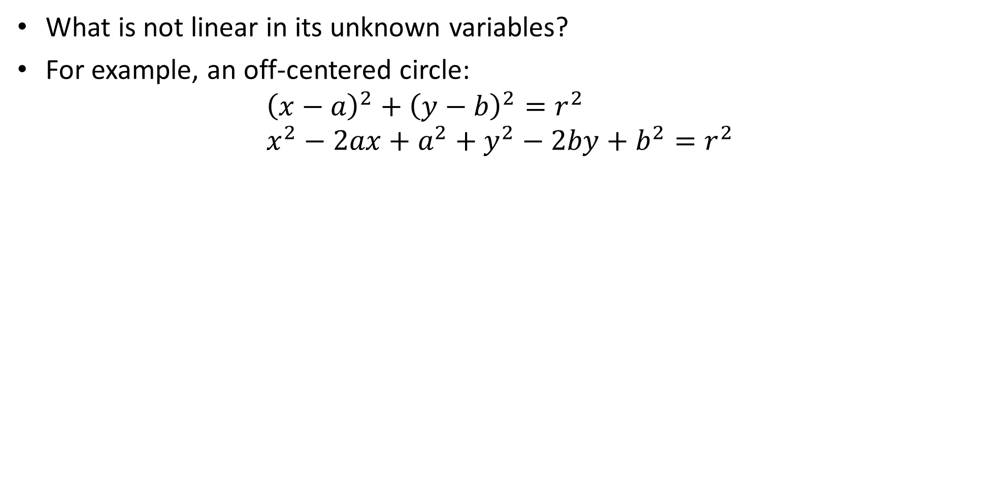
Linearity assumption
What is not linear in its unknown variables?
For example, an off-centered circle:
$${\left(x−a\right)}^{2}+{\left(y−b\right)}^{2}=r^{2} \\ x^{2}−2ax+a^{2}+y^{2}−2by+b^{2}=r^{2}$$

Slide 11
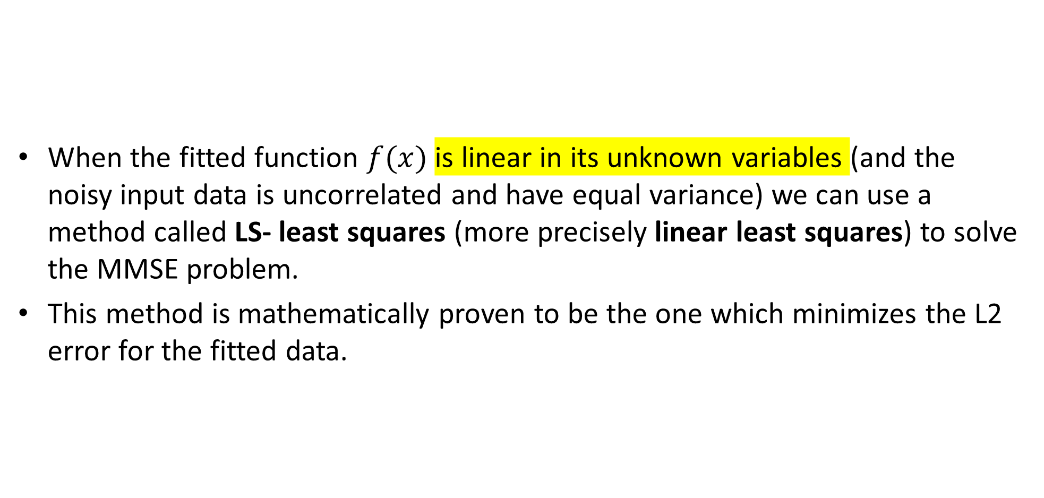
MMSE & Least squares
When the fitted function $f(x)$ is linear in its unknown variables (and the noisy input data is uncorrelated and have equal variance) we can use a method called LS- least squares (more precisely linear least squares) to solve the MMSE problem.
This method is mathematically proven to be the one which minimizes the L2 error for the fitted data.

Slide 12
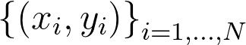
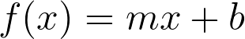
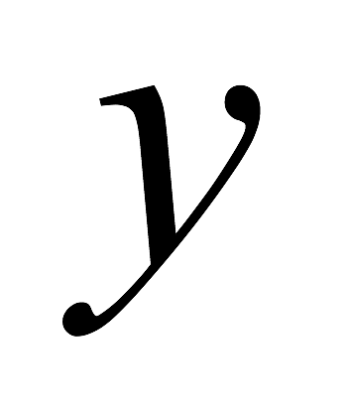
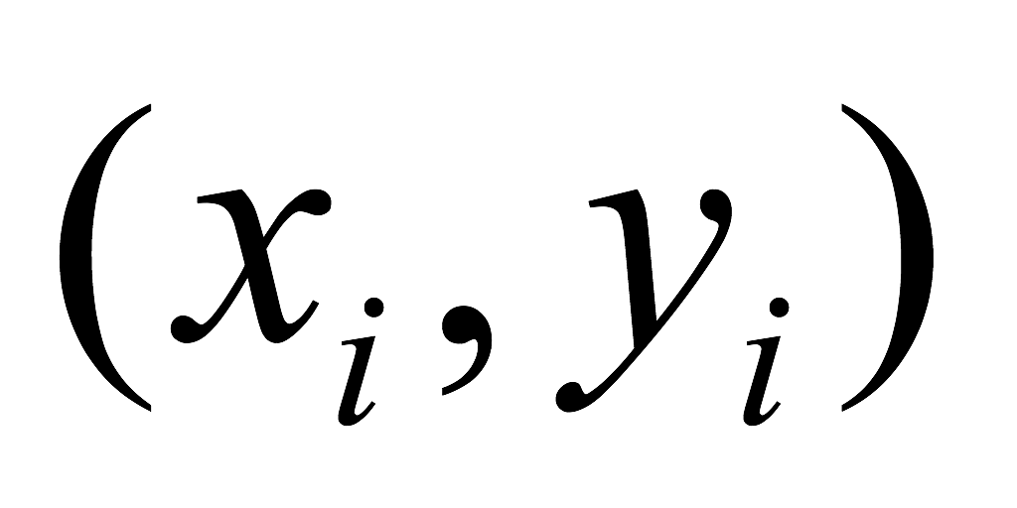
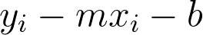

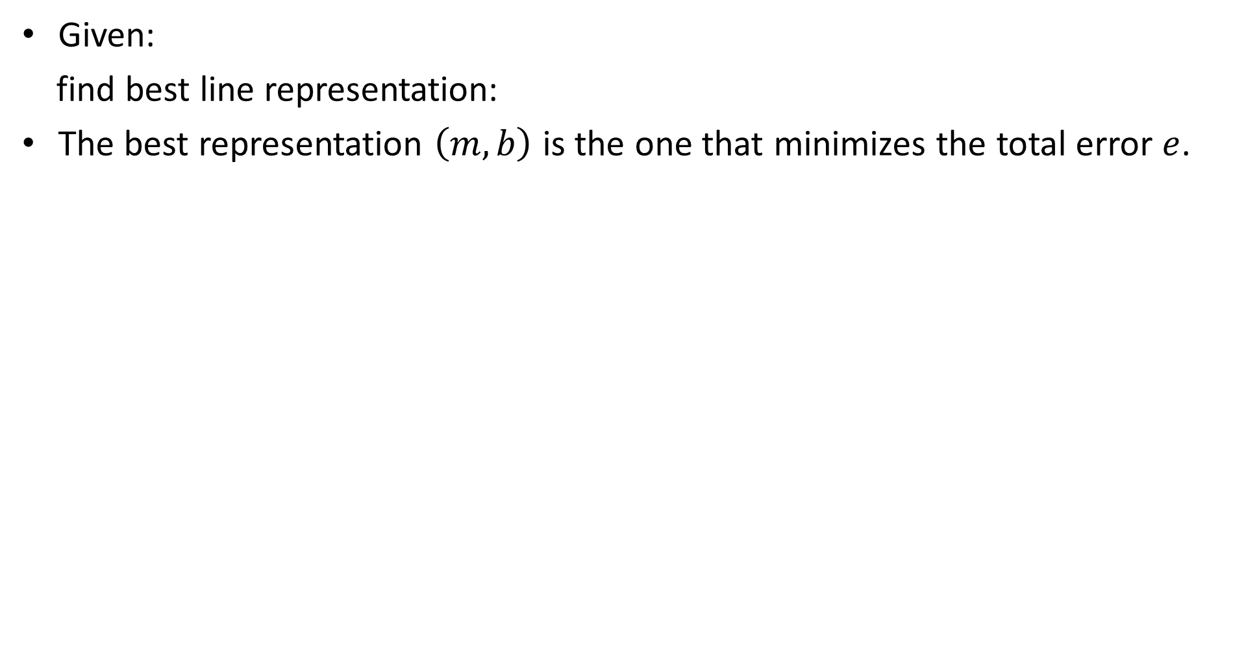
Line fitting- least squares (LS): step by step example
Given:
find best line representation:
The best representation $\left(m,b\right)$ is the one that minimizes the total error $e$.
Notes:
\left \{ (x_i,y_i)\right \}_{i=1,...,N}
e=\frac{1}{N}\sum_{i=1}^{N} (y_i-f(x_i))^2
f(x)=mx+b
y_i-mx_i-b
e=\frac{1}{N}\sum_{i=1}^{N} (y_i-mx_i-b)^2

Slide 13
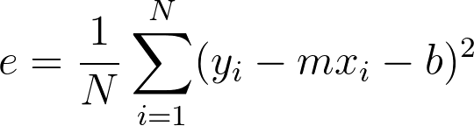
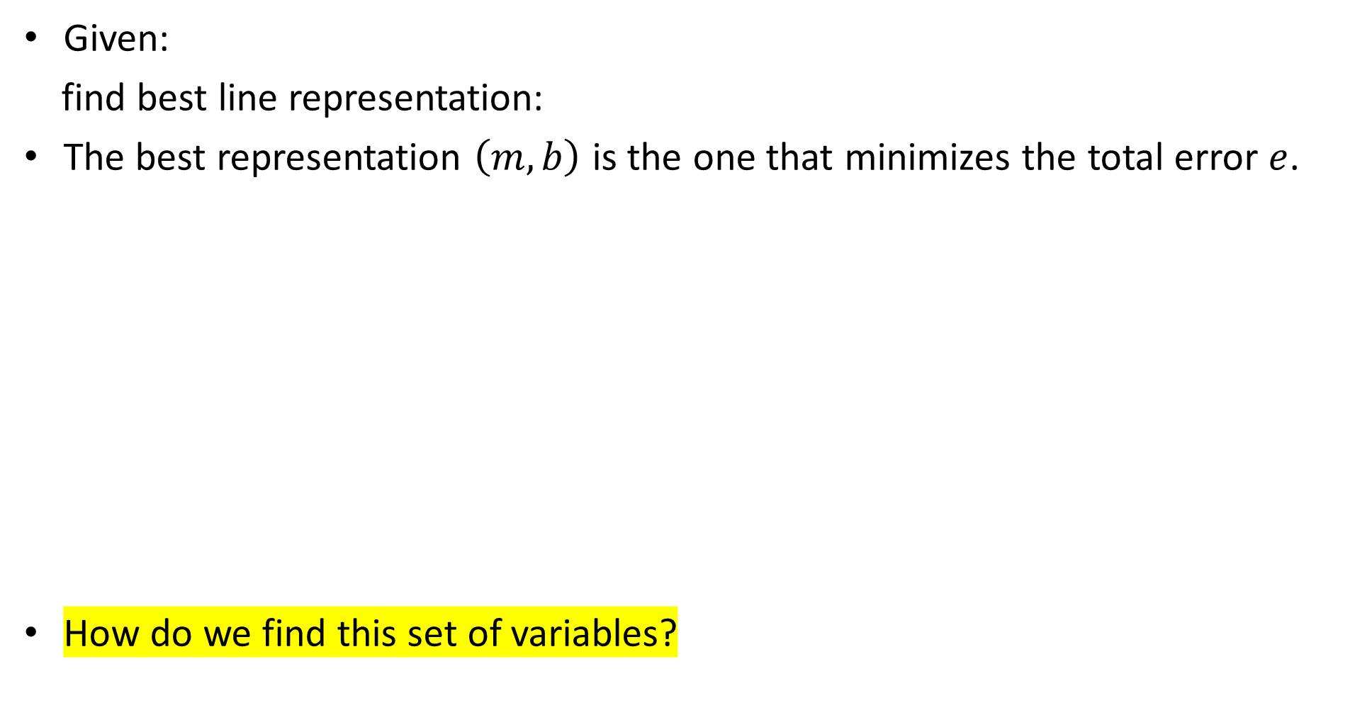
Line fitting- least squares (LS): step by step example
Given:
find best line representation:
The best representation $\left(m,b\right)$ is the one that minimizes the total error $e$.
How do we find this set of variables?
Notes:
\left \{ (x_i,y_i)\right \}_{i=1,...,N}
e=\frac{1}{N}\sum_{i=1}^{N} (y_i-f(x_i))^2
f(x)=mx+b
y_i-mx_i-b
e=\frac{1}{N}\sum_{i=1}^{N} (y_i-mx_i-b)^2

Slide 14
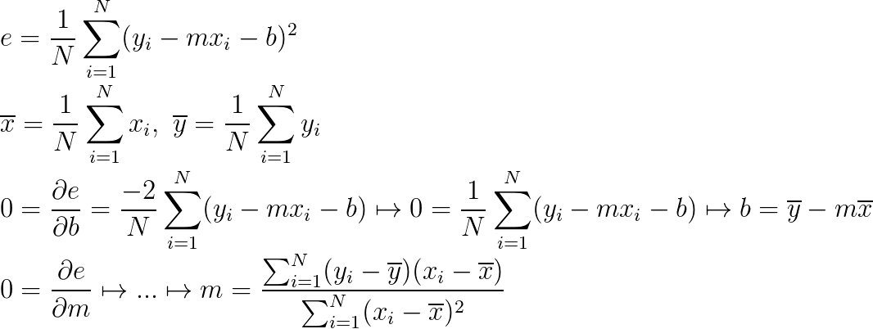
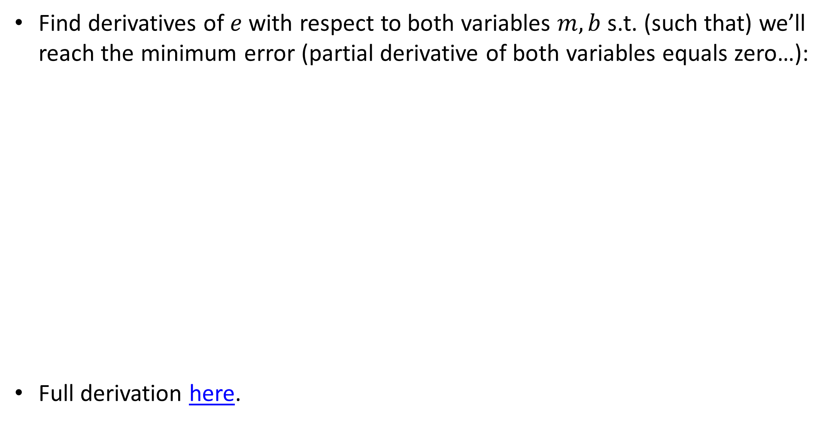
Line fitting- least squares (LS): step by step example
Find derivatives of $e$ with respect to both variables $m,b$s.t. (such that) we’ll reach the minimum error (partial derivative of both variables equals zero…):
Full derivation here.
Notes:
\\
e =\frac{1}{N}\sum_{i=1}^{N} (y_i-mx_i-b)^2
\\
\overline{x}=\frac{1}{N}\sum_{i=1}^{N} x_i , \,\, \overline{y}=\frac{1}{N}\sum_{i=1}^{N} y_i
\\
0=\frac{\partial e}{\partial b} =\frac{-2}{N}\sum_{i=1}^{N} (y_i-mx_i-b) \mapsto 0 =\frac{1}{N}\sum_{i=1}^{N} (y_i-mx_i-b)\mapsto b=\overline{y}-m\overline{x}
\\
0=\frac{\partial e}{\partial m} \mapsto ...\mapsto m = \frac{\sum_{i=1}^{N} (y_i-\overline{y})(x_i-\overline{x}) }{\sum_{i=1}^{N}(x_i-\overline{x}) ^2}

Slide 15
Line fitting- least squares (LS): step by step example
Find derivatives of $e$ with respect to both variables $m,b$s.t. (such that) we’ll reach the minimum error (partial derivative of both variables equals zero…):
Full derivation here.

Slide 16
Line fitting- least squares (LS): step by step example
Find derivatives of $e$ with respect to both variables $m,b$s.t. (such that) we’ll reach the minimum error (partial derivative of both variables equals zero…):
Full derivation here.

Slide 17
Line fitting- least squares (LS): step by step example
Find derivatives of $e$ with respect to both variables $m,b$s.t. (such that) we’ll reach the minimum error (partial derivative of both variables equals zero…):
Full derivation here.

Slide 18
Line fitting- least squares (LS): step by step example
Find derivatives of $e$ with respect to both variables $m,b$s.t. (such that) we’ll reach the minimum error (partial derivative of both variables equals zero…):
Full derivation here.

Slide 19
Line fitting- least squares (LS): step by step example
Find derivatives of $e$ with respect to both variables $m,b$s.t. (such that) we’ll reach the minimum error (partial derivative of both variables equals zero…):
Full derivation here.

Slide 20
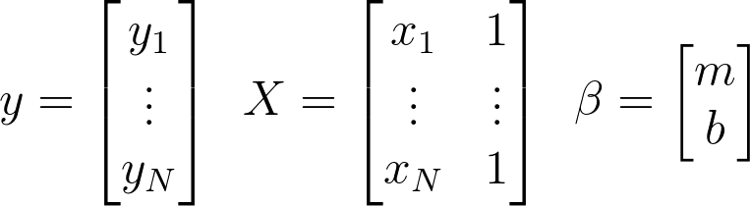
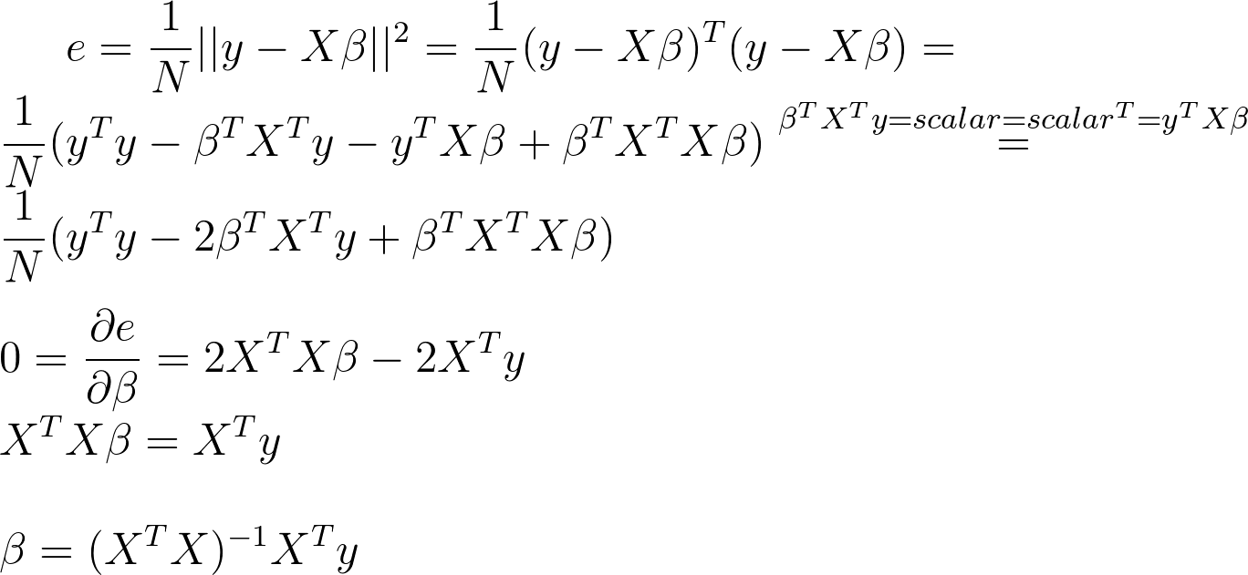
Line fitting - LS in matrix form
Notes:
y =
\begin{bmatrix}
y_1\\
\vdots\\
y_N
\end{bmatrix}
\,\,\,
X=
\begin{bmatrix}
x_1&1\\
\vdots&\vdots\\
x_N&1
\end{bmatrix}
\,\,\,
\beta=
\begin{bmatrix}
m\\
b
\end{bmatrix}
e = \frac{1}{N}||y-X\beta||^2 = \frac{1}{N}(y-X\beta)^T(y-X\beta)=\\
\frac{1}{N}(y^Ty-\beta^TX^Ty-y^TX\beta+\beta^TX^TX\beta)\stackrel{\beta^TX^Ty=scalar=scalar^T=y^TX\beta}{=}\\
\frac{1}{N}(y^Ty-2\beta^TX^Ty+\beta^TX^TX\beta)\\
\\
0=\frac{\partial e}{\partial \beta}=2X^TX\beta-2X^Ty\\
X^TX\beta=X^Ty\\
\\
\beta = (X^TX)^{-1}X^Ty

Slide 21
Line fitting - LS in matrix form
Notes:
y =
\begin{bmatrix}
y_1\\
\vdots\\
y_N
\end{bmatrix}
\,\,\,
X=
\begin{bmatrix}
x_1&1\\
\vdots&\vdots\\
x_N&1
\end{bmatrix}
\,\,\,
\beta=
\begin{bmatrix}
m\\
b
\end{bmatrix}
e = \frac{1}{N}||y-X\beta||^2 = \frac{1}{N}(y-X\beta)^T(y-X\beta)=\\
\frac{1}{N}(y^Ty-\beta^TX^Ty-y^TX\beta+\beta^TX^TX\beta)\stackrel{\beta^TX^Ty=scalar=scalar^T=y^TX\beta}{=}\\
\frac{1}{N}(y^Ty-2\beta^TX^Ty+\beta^TX^TX\beta)\\
\\
0=\frac{\partial e}{\partial \beta}=2X^TX\beta-2X^Ty\\
X^TX\beta=X^Ty\\
\\
\beta = (X^TX)^{-1}X^Ty

Slide 22
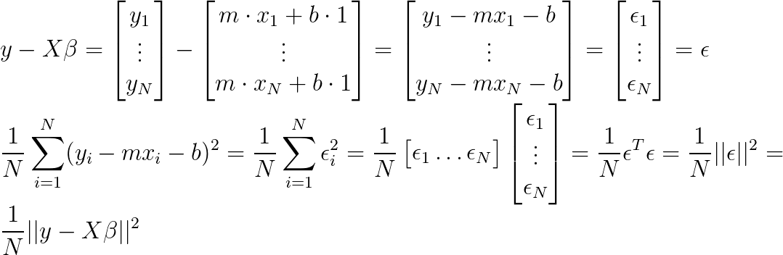
Line fitting - LS in matrix form
Notes:
\\
y-X\beta=
\begin{bmatrix}
y_1\\
\vdots\\
y_N
\end{bmatrix}
-
\begin{bmatrix}
m\cdot x_1+b\cdot 1\\
\vdots\\
m\cdot x_N+b\cdot 1
\end{bmatrix}
=
\begin{bmatrix}
y_1-mx_1-b\\
\vdots\\
y_N-mx_N-b
\end{bmatrix}
=
\begin{bmatrix}
\epsilon_1\\
\vdots\\
\epsilon_N
\end{bmatrix}
=
\epsilon
\\
\frac{1}{N}\sum_{i=1}^N(y_i-mx_i-b)^2=
\frac{1}{N}\sum_{i=1}^N\epsilon_i^2=
\frac{1}{N}\begin{bmatrix}
\epsilon_1 \hdots \epsilon_N
\end{bmatrix}
\begin{bmatrix}
\epsilon_1\\
\vdots\\
\epsilon_N
\end{bmatrix}
=
\frac{1}{N}\epsilon^T\epsilon
=
\frac{1}{N}||\epsilon||^2
=
\frac{1}{N}||y-X\beta||^2

Slide 23
Line fitting - LS in matrix form
Notes:
\\
y-X\beta=
\begin{bmatrix}
y_1\\
\vdots\\
y_N
\end{bmatrix}
-
\begin{bmatrix}
m\cdot x_1+b\cdot 1\\
\vdots\\
m\cdot x_N+b\cdot 1
\end{bmatrix}
=
\begin{bmatrix}
y_1-mx_1-b\\
\vdots\\
y_N-mx_N-b
\end{bmatrix}
=
\begin{bmatrix}
e_1\\
\vdots\\
e_N
\end{bmatrix}
=
e
\\
\sum_{i=1}^N(y_i-mx_i-b)^2=
\sum_{i=1}^Ne_i^2=
\begin{bmatrix}
e_1 \hdots e_N
\end{bmatrix}
\begin{bmatrix}
e_1\\
\vdots\\
e_N
\end{bmatrix}
=
e^Te
=
||e||^2
=
||y-X\beta||^2

Slide 24
Line fitting - LS in matrix form
Notes:
y =
\begin{bmatrix}
y_1\\
\vdots\\
y_N
\end{bmatrix}
\,\,\,
X=
\begin{bmatrix}
x_1&1\\
\vdots&\vdots\\
x_N&1
\end{bmatrix}
\,\,\,
\beta=
\begin{bmatrix}
m\\
b
\end{bmatrix}
e = \frac{1}{N}||y-X\beta||^2 = \frac{1}{N}(y-X\beta)^T(y-X\beta)=\\
\frac{1}{N}(y^Ty-\beta^TX^Ty-y^TX\beta+\beta^TX^TX\beta)\stackrel{\beta^TX^Ty=scalar=scalar^T=y^TX\beta}{=}\\
\frac{1}{N}(y^Ty-2\beta^TX^Ty+\beta^TX^TX\beta)\\
\\
0=\frac{\partial e}{\partial \beta}=2X^TX\beta-2X^Ty\\
X^TX\beta=X^Ty\\
\\
\beta = (X^TX)^{-1}X^Ty

Slide 25
Line fitting - LS in matrix form
Notes:
y =
\begin{bmatrix}
y_1\\
\vdots\\
y_N
\end{bmatrix}
\,\,\,
X=
\begin{bmatrix}
x_1&1\\
\vdots&\vdots\\
x_N&1
\end{bmatrix}
\,\,\,
\beta=
\begin{bmatrix}
m\\
b
\end{bmatrix}
e = \frac{1}{N}||y-X\beta||^2 = \frac{1}{N}(y-X\beta)^T(y-X\beta)=\\
\frac{1}{N}(y^Ty-\beta^TX^Ty-y^TX\beta+\beta^TX^TX\beta)\stackrel{\beta^TX^Ty=scalar=scalar^T=y^TX\beta}{=}\\
\frac{1}{N}(y^Ty-2\beta^TX^Ty+\beta^TX^TX\beta)\\
\\
0=\frac{\partial e}{\partial \beta}=2X^TX\beta-2X^Ty\\
X^TX\beta=X^Ty\\
\\
\beta = (X^TX)^{-1}X^Ty

Slide 26
Line fitting - LS in matrix form
Notes:
y =
\begin{bmatrix}
y_1\\
\vdots\\
y_N
\end{bmatrix}
\,\,\,
X=
\begin{bmatrix}
x_1&1\\
\vdots&\vdots\\
x_N&1
\end{bmatrix}
\,\,\,
\beta=
\begin{bmatrix}
m\\
b
\end{bmatrix}
e = \frac{1}{N}||y-X\beta||^2 = \frac{1}{N}(y-X\beta)^T(y-X\beta)=\\
\frac{1}{N}(y^Ty-\beta^TX^Ty-y^TX\beta+\beta^TX^TX\beta)\stackrel{\beta^TX^Ty=scalar=scalar^T=y^TX\beta}{=}\\
\frac{1}{N}(y^Ty-2\beta^TX^Ty+\beta^TX^TX\beta)\\
\\
0=\frac{\partial e}{\partial \beta}=2X^TX\beta-2X^Ty\\
X^TX\beta=X^Ty\\
\\
\beta = (X^TX)^{-1}X^Ty

Slide 27
Line fitting - LS in matrix form
Notes:
y =
\begin{bmatrix}
y_1\\
\vdots\\
y_N
\end{bmatrix}
\,\,\,
X=
\begin{bmatrix}
x_1&1\\
\vdots&\vdots\\
x_N&1
\end{bmatrix}
\,\,\,
\beta=
\begin{bmatrix}
m\\
b
\end{bmatrix}
e = \frac{1}{N}||y-X\beta||^2 = \frac{1}{N}(y-X\beta)^T(y-X\beta)=\\
\frac{1}{N}(y^Ty-\beta^TX^Ty-y^TX\beta+\beta^TX^TX\beta)\stackrel{\beta^TX^Ty=scalar=scalar^T=y^TX\beta}{=}\\
\frac{1}{N}(y^Ty-2\beta^TX^Ty+\beta^TX^TX\beta)\\
\\
0=\frac{\partial e}{\partial \beta}=2X^TX\beta-2X^Ty\\
X^TX\beta=X^Ty\\
\\
\beta = (X^TX)^{-1}X^Ty

Slide 28
Line fitting - LS in matrix form
Notes:
y =
\begin{bmatrix}
y_1\\
\vdots\\
y_N
\end{bmatrix}
\,\,\,
X=
\begin{bmatrix}
x_1&1\\
\vdots&\vdots\\
x_N&1
\end{bmatrix}
\,\,\,
\beta=
\begin{bmatrix}
m\\
b
\end{bmatrix}
e = \frac{1}{N}||y-X\beta||^2 = \frac{1}{N}(y-X\beta)^T(y-X\beta)=\\
\frac{1}{N}(y^Ty-\beta^TX^Ty-y^TX\beta+\beta^TX^TX\beta)\stackrel{\beta^TX^Ty=scalar=scalar^T=y^TX\beta}{=}\\
\frac{1}{N}(y^Ty-2\beta^TX^Ty+\beta^TX^TX\beta)\\
\\
0=\frac{\partial e}{\partial \beta}=2X^TX\beta-2X^Ty\\
X^TX\beta=X^Ty\\
\\
\beta = (X^TX)^{-1}X^Ty

Slide 29
Line fitting - LS in matrix form
Notes:
y =
\begin{bmatrix}
y_1\\
\vdots\\
y_N
\end{bmatrix}
\,\,\,
X=
\begin{bmatrix}
x_1&1\\
\vdots&\vdots\\
x_N&1
\end{bmatrix}
\,\,\,
\beta=
\begin{bmatrix}
m\\
b
\end{bmatrix}
e = \frac{1}{N}||y-X\beta||^2 = \frac{1}{N}(y-X\beta)^T(y-X\beta)=\\
\frac{1}{N}(y^Ty-\beta^TX^Ty-y^TX\beta+\beta^TX^TX\beta)\stackrel{\beta^TX^Ty=scalar=scalar^T=y^TX\beta}{=}\\
\frac{1}{N}(y^Ty-2\beta^TX^Ty+\beta^TX^TX\beta)\\
\\
0=\frac{\partial e}{\partial \beta}=2X^TX\beta-2X^Ty\\
X^TX\beta=X^Ty\\
\\
\beta = (X^TX)^{-1}X^Ty

Slide 30
Line fitting - LS in matrix form
Notes:
y =
\begin{bmatrix}
y_1\\
\vdots\\
y_N
\end{bmatrix}
\,\,\,
X=
\begin{bmatrix}
x_1&1\\
\vdots&\vdots\\
x_N&1
\end{bmatrix}
\,\,\,
\beta=
\begin{bmatrix}
m\\
b
\end{bmatrix}
e = \frac{1}{N}||y-X\beta||^2 = \frac{1}{N}(y-X\beta)^T(y-X\beta)=\\
\frac{1}{N}(y^Ty-\beta^TX^Ty-y^TX\beta+\beta^TX^TX\beta)\stackrel{\beta^TX^Ty=scalar=scalar^T=y^TX\beta}{=}\\
\frac{1}{N}(y^Ty-2\beta^TX^Ty+\beta^TX^TX\beta)\\
\\
0=\frac{\partial e}{\partial \beta}=2X^TX\beta-2X^Ty\\
X^TX\beta=X^Ty\\
\\
\beta = (X^TX)^{-1}X^Ty

Slide 31
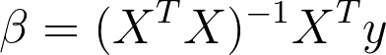
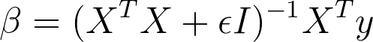
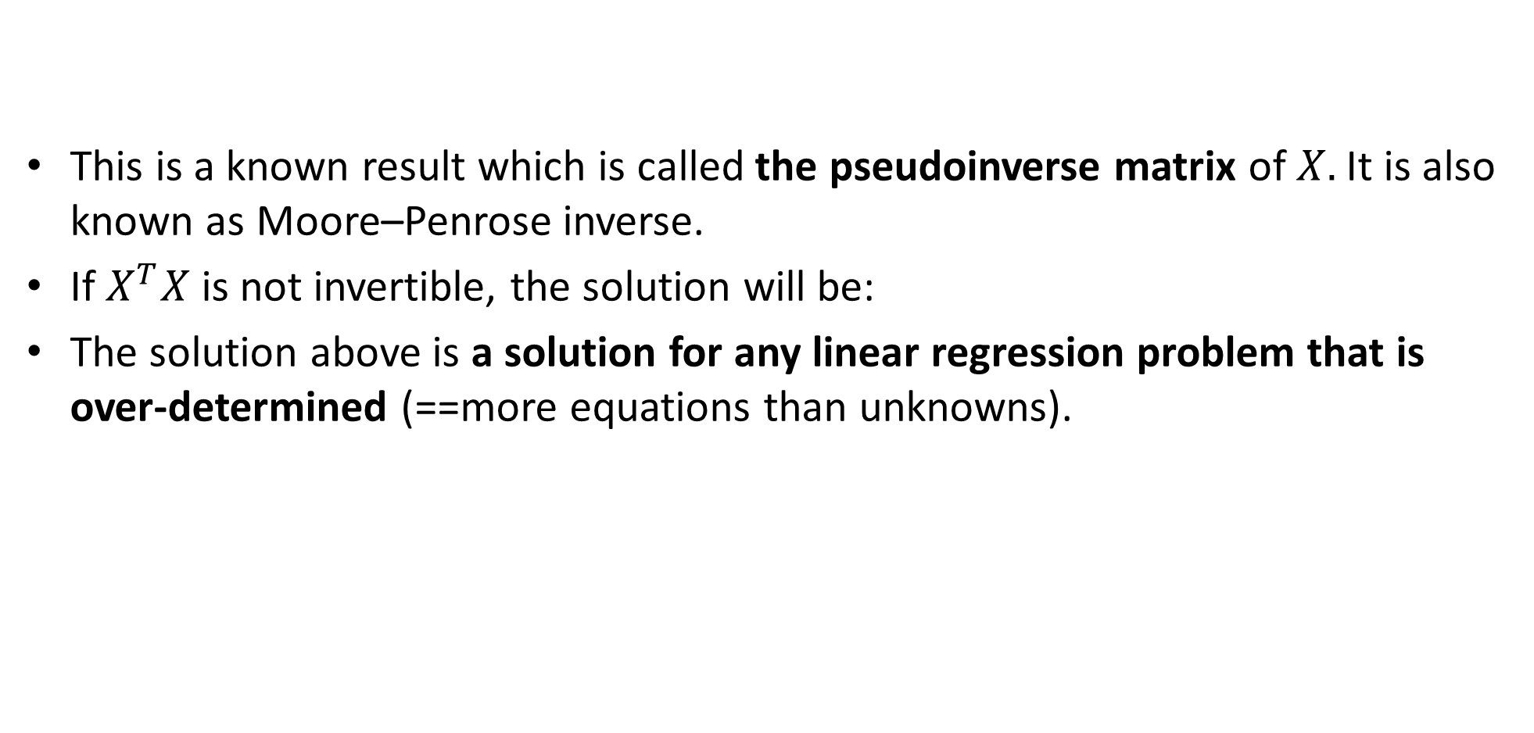
Side note: pseudoinverse
This is a known result which is called the pseudoinverse matrix of$X.$ It is also known as Moore–Penrose inverse.
If $X^{T}X$is not invertible, the solution will be:
The solution above is a solution for any linear regression problem that is over-determined (==more equations than unknowns).
Notes:
\beta = (X^TX+\epsilon I)^{-1}X^Ty

Slide 32
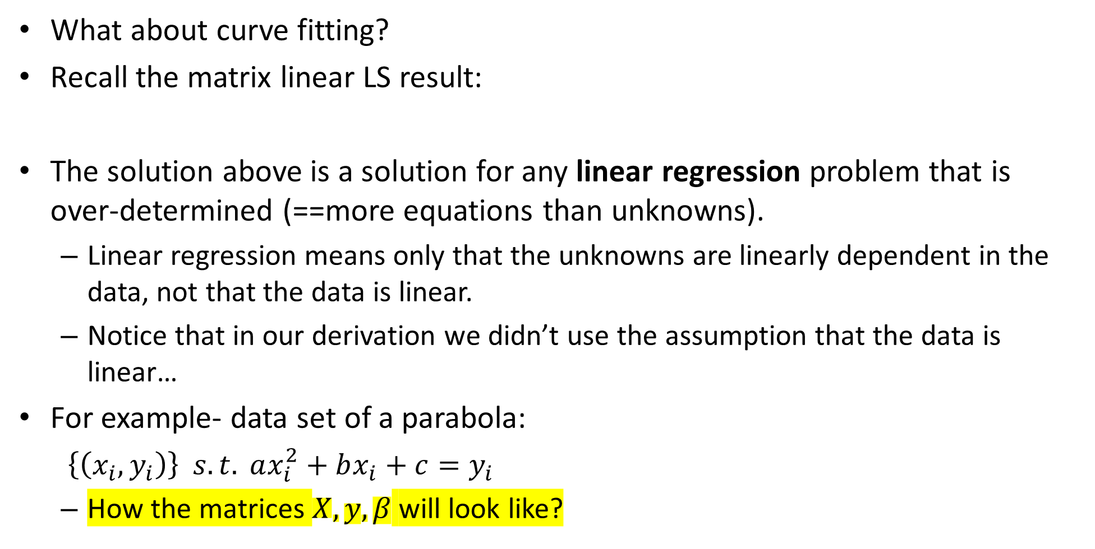
Curve fitting - LS
What about curve fitting?
Recall the matrix linear LS result:
The solution above is a solution for any linear regression problem that is over-determined (==more equations than unknowns).
Linear regression means only that the unknowns are linearly dependent in the data, not that the data is linear.
Notice that in our derivation we didn’t use the assumption that the data is linear…
For example- data set of a parabola:
$\left\{\left(x_{i},y_{i}\right)\right\} s.t. ax_{i}^{2}+bx_{i}+c=y_{i}$
How the matrices $X,y,β$ will look like?
Notes:
\beta = (X^TX+\epsilon I)^{-1}X^Ty
y =
\begin{bmatrix}
y_1\\
\vdots\\
y_N
\end{bmatrix}
\,\,\,
X=
\begin{bmatrix}
x_1^2&x_1&1\\
\vdots&\vdots&\vdots\\
x_N^2&x_N&1
\end{bmatrix}
\,\,\,
\beta=
\begin{bmatrix}
a\\
b\\
c
\end{bmatrix}

Slide 33
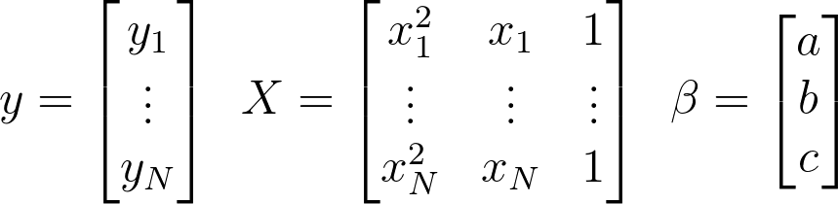
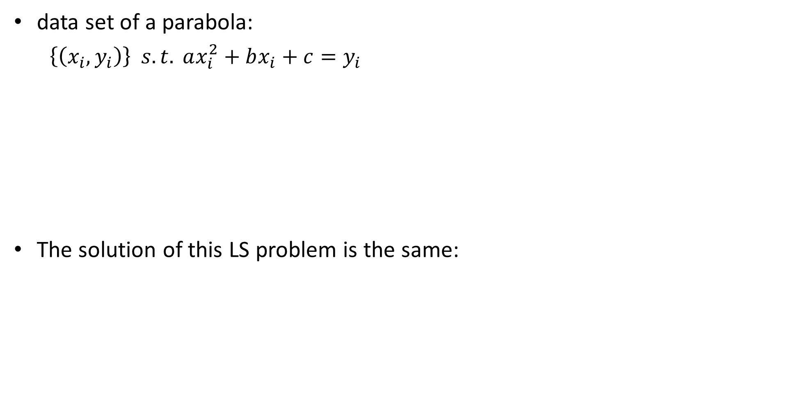
Curve fitting - LS
data set of a parabola:
$\left\{\left(x_{i},y_{i}\right)\right\} s.t. ax_{i}^{2}+bx_{i}+c=y_{i}$
The solution of this LS problem is the same:
Notes:
y =
\begin{bmatrix}
y_1\\
\vdots\\
y_N
\end{bmatrix}
\,\,\,
X=
\begin{bmatrix}
x_1^2&x_1&1\\
\vdots&\vdots&\vdots\\
x_N^2&x_N&1
\end{bmatrix}
\,\,\,
\beta=
\begin{bmatrix}
a\\
b\\
c
\end{bmatrix}

Slide 34
least_squares.ipynb

Slide 35
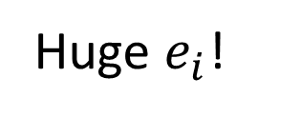
Problem 1: fitting vertical data
Near vertical data is hard to fit since the error is computed perpendicular to x axis- the bigger the error, the bigger the error squared! (more weight for this datapoint).
Proposed solutions?
Huge $e_{i}$!

Slide 36
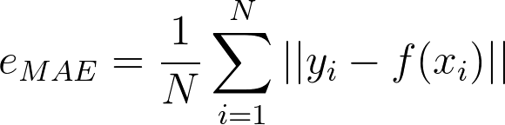
Problem 1: fitting vertical data
One possible solution is making all errors weigh the same (and not squared). This will make the far points have the same impact on error as closer points. One such error MAE (mean absolute error, also known as L1 loss) instead of MSE.
The derivation of MAE is out of the class scope, but some details can be found here.
Another possible solution is computing the error distance of each point in a different way- one that takes into account the y data as well. One such algorithm is total least squares.
Notes:
e_{MAE}=\frac{1}{N}\sum_{i=1}^{N} ||y_i-f(x_i)||

Slide 37
TOC
Least squares
Total least squares
RANSAC

Slide 38
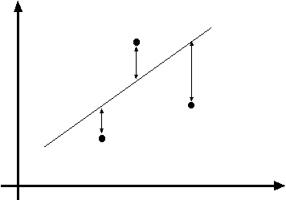
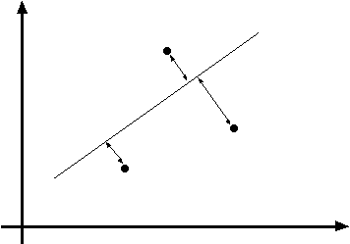
Line fitting- total least squares

Slide 39
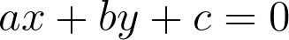
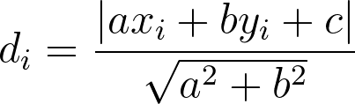
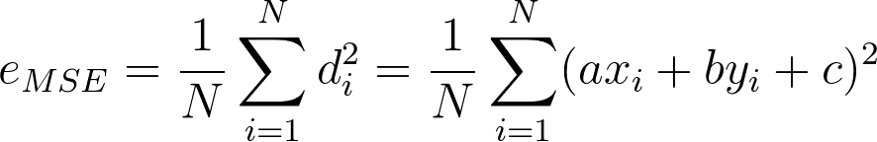
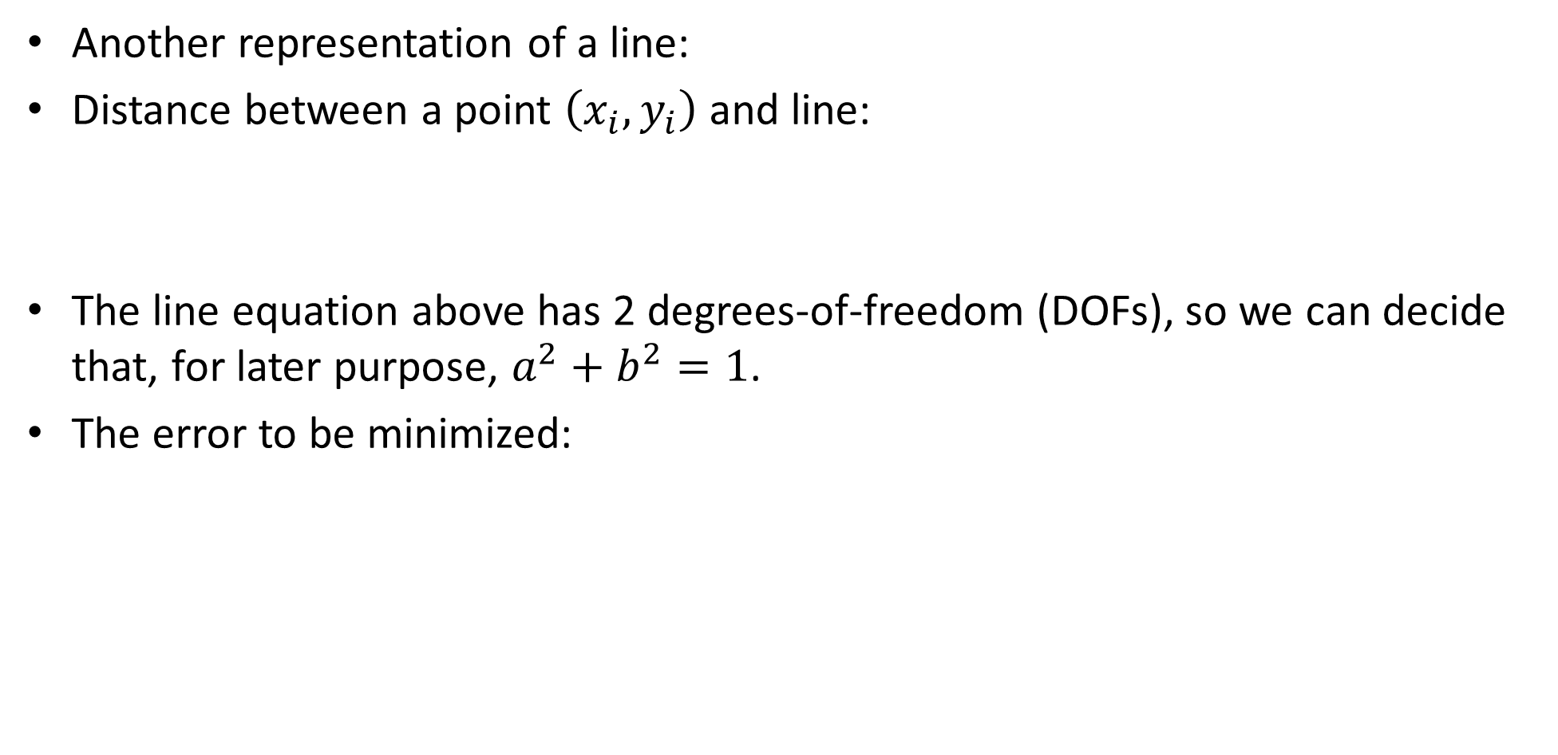
Line fitting- TLS
Another representation of a line:
Distance between a point $\left(x_{i},y_{i}\right)$ and line:
The line equation above has 2 degrees-of-freedom (DOFs), so we can decide that, for later purpose, $a^{2}+b^{2}=1$.
The error to be minimized:
Notes:
ax+by+c=0
d_i = \frac{|ax_i+by_i+c|}{\sqrt{a^2+b^2}}
e_{MSE}=\frac{1}{N}\sum_{i=1}^{N}d_i^2=\frac{1}{N}\sum_{i=1}^{N} (ax_i+by_i+c)^2

Slide 40
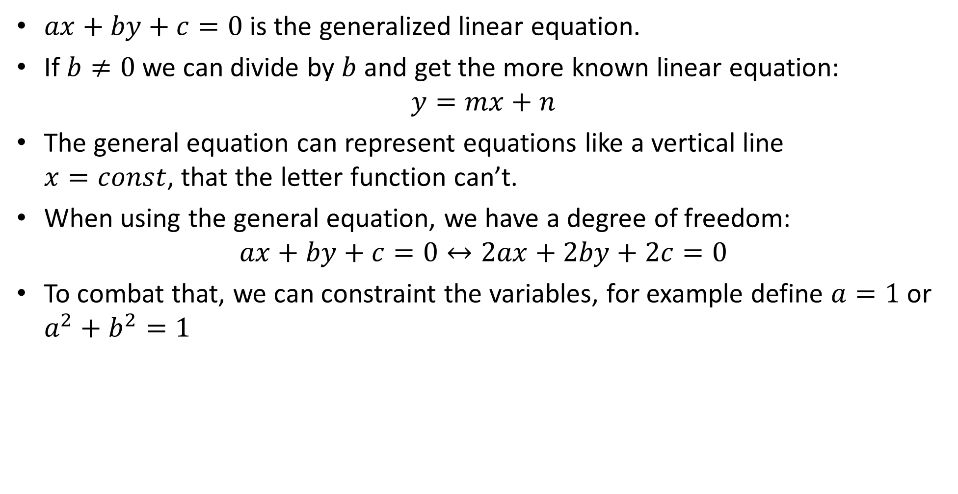
Side note: general line equation
$ax+by+c=0$is the generalized linear equation.
If $b≠0$ we can divide by $b$ and get the more known linear equation:
The general equation can represent equations like a vertical line $x=const$, that the letter function can’t.
When using the general equation, we have a degree of freedom:
$$ax+by+c=0↔2ax+2by+2c=0$$
To combat that, we can constraint the variables, for example define $a=1$or $a^{2}+b^{2}=1$

Slide 41
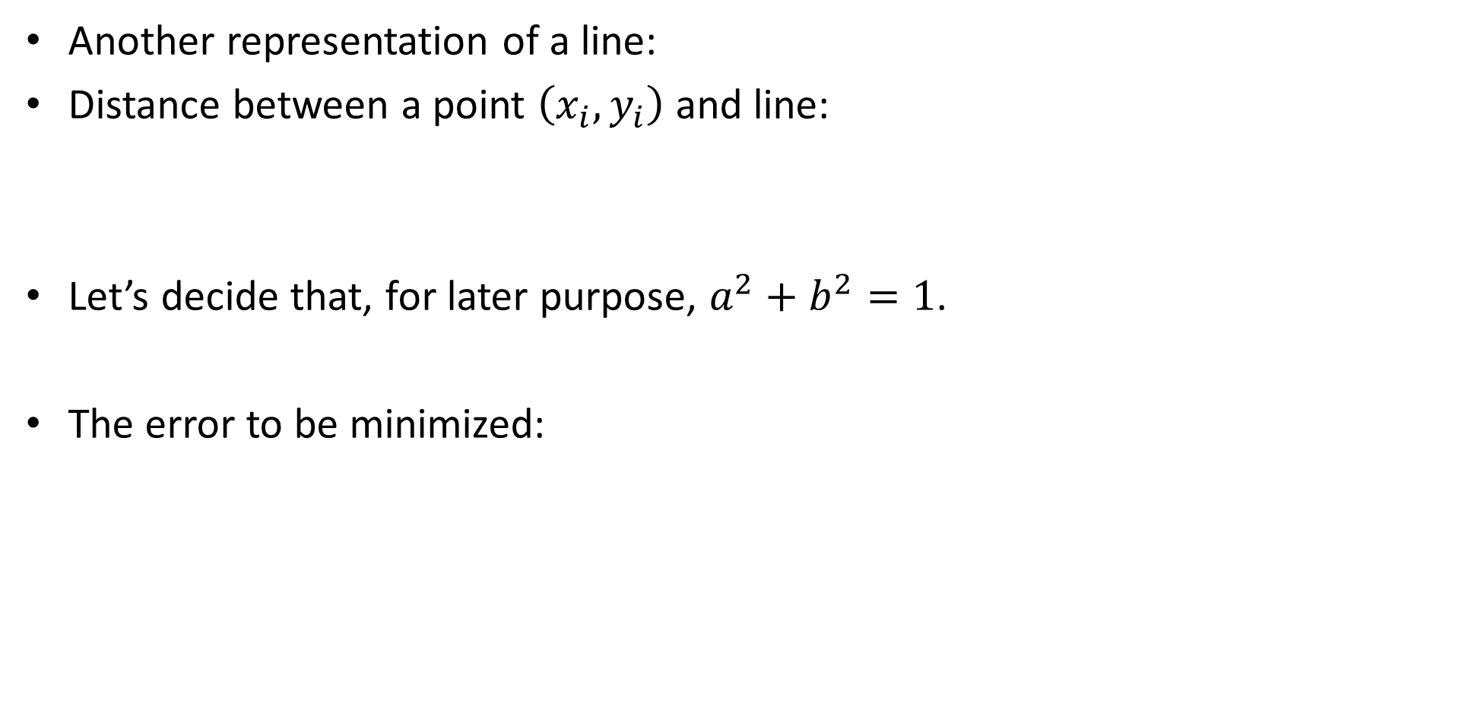
Line fitting- TLS
Another representation of a line:
Distance between a point $\left(x_{i},y_{i}\right)$ and line:
Let’s decide that, for later purpose, $a^{2}+b^{2}=1$.
The error to be minimized:
Notes:
ax+by+c=0
d_i = \frac{|ax_i+by_i+c|}{\sqrt{a^2+b^2}}
e_{MSE}=\frac{1}{N}\sum_{i=1}^{N}d_i^2=\frac{1}{N}\sum_{i=1}^{N} (ax_i+by_i+c)^2

Slide 42
Line fitting- TLS
Another representation of a line:
Distance between a point $\left(x_{i},y_{i}\right)$ and line:
Let’s decide that, for later purpose, $a^{2}+b^{2}=1$.
The error to be minimized:
Notes:
ax+by+c=0
d_i = \frac{|ax_i+by_i+c|}{\sqrt{a^2+b^2}}
e_{MSE}=\frac{1}{N}\sum_{i=1}^{N}d_i^2=\frac{1}{N}\sum_{i=1}^{N} (ax_i+by_i+c)^2

Slide 43
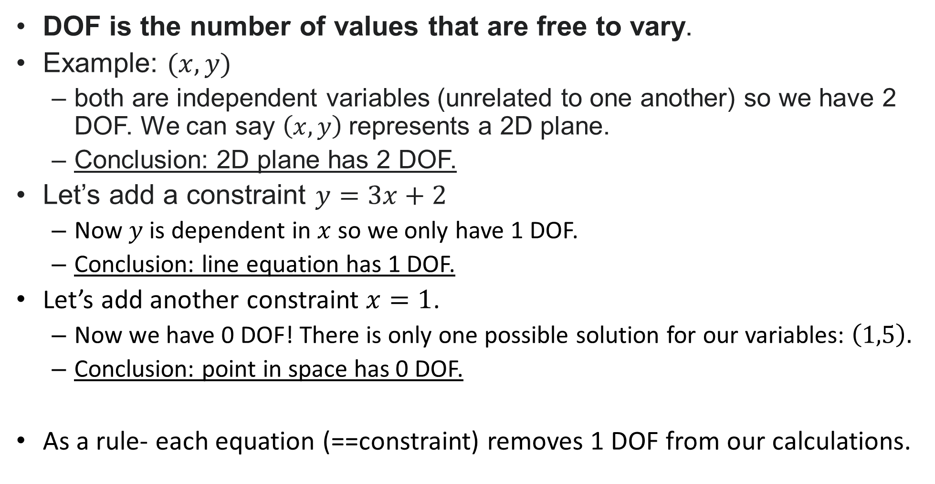
Side note: DOFs- degrees of freedom
DOF is the number of values that are free to vary.
Example: $(x,y)$
both are independent variables (unrelated to one another) so we have 2 DOF. We can say $\left(x,y\right)$represents a 2D plane.
Conclusion: 2D plane has 2 DOF.
Let’s add a constraint $y=3x+2$
Now $y$is dependent in $x$ so we only have 1 DOF.
Conclusion: line equation has 1 DOF.
Let’s add another constraint $x=1$.
Now we have 0 DOF! There is only one possible solution for our variables: $\left(1,5\right).$
Conclusion: point in space has 0 DOF.
As a rule- each equation (==constraint) removes 1 DOF from our calculations.

Slide 44
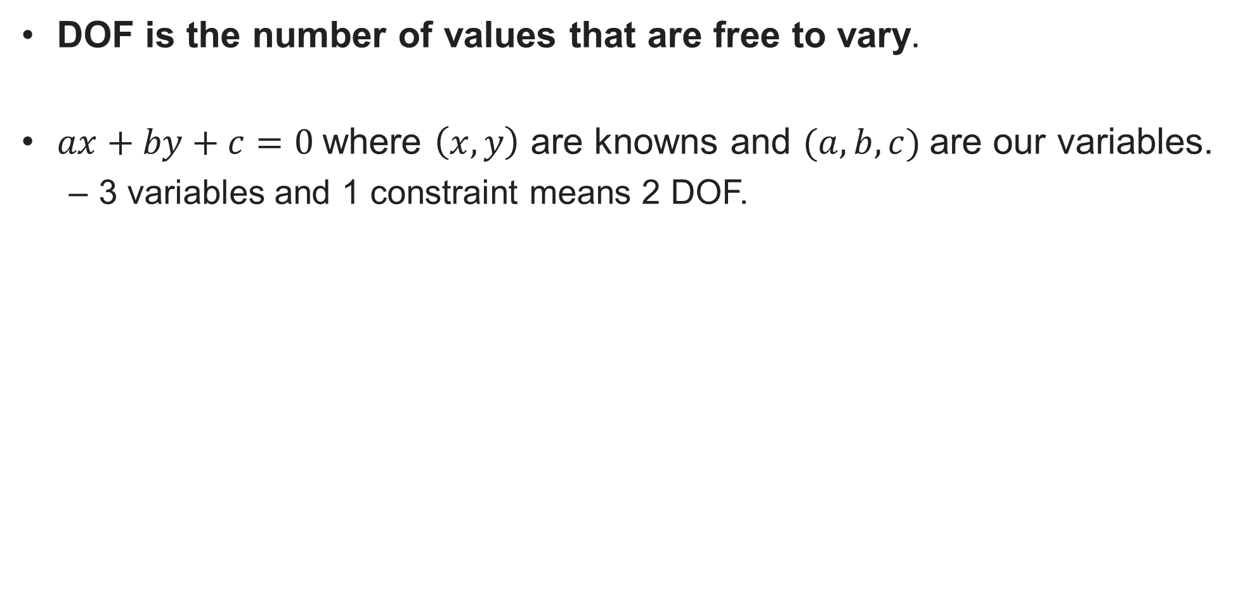
Side note: DOFs- degrees of freedom
DOF is the number of values that are free to vary.
$ax+by+c=0$where $\left(x,y\right)$ are knowns and $(a,b,c)$are our variables.
3 variables and 1 constraint means 2 DOF.

Slide 45
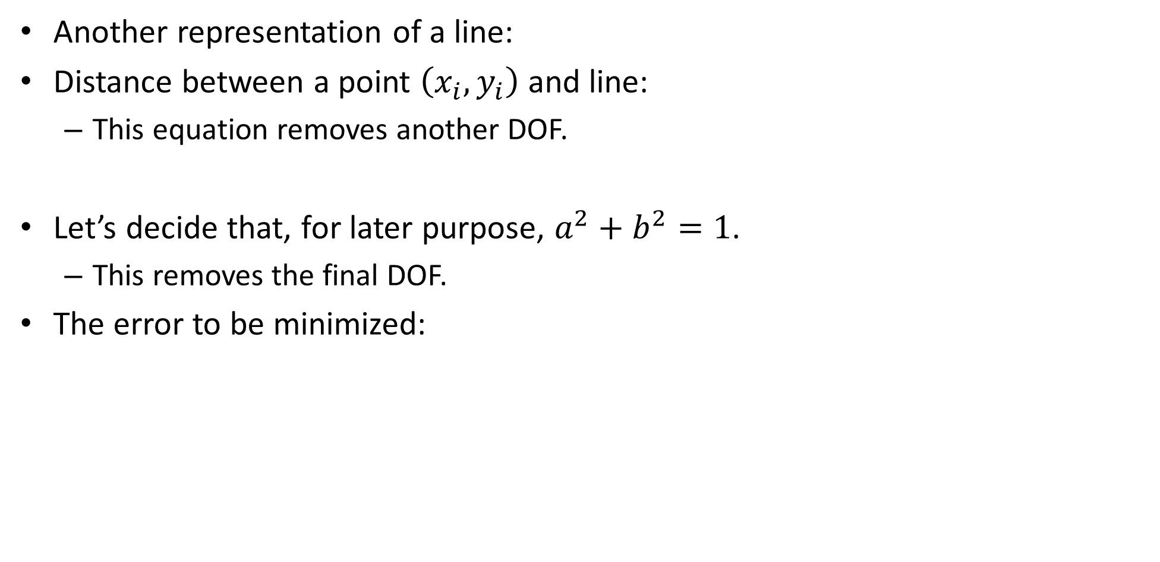
Line fitting- TLS
Another representation of a line:
Distance between a point $\left(x_{i},y_{i}\right)$ and line:
This equation removes another DOF.
Let’s decide that, for later purpose, $a^{2}+b^{2}=1$.
This removes the final DOF.
The error to be minimized:
Notes:
ax+by+c=0
d_i = \frac{|ax_i+by_i+c|}{\sqrt{a^2+b^2}}
e_{MSE}=\frac{1}{N}\sum_{i=1}^{N}d_i^2=\frac{1}{N}\sum_{i=1}^{N} (ax_i+by_i+c)^2

Slide 46
Line fitting- TLS
Another representation of a line:
Distance between a point $\left(x_{i},y_{i}\right)$ and line:
This equation removes another DOF.
Let’s decide that, for later purpose, $a^{2}+b^{2}=1$.
This removes the final DOF.
The error to be minimized:
Notes:
ax+by+c=0
d_i = \frac{|ax_i+by_i+c|}{\sqrt{a^2+b^2}}
e_{MSE}=\frac{1}{N}\sum_{i=1}^{N}d_i^2=\frac{1}{N}\sum_{i=1}^{N} (ax_i+by_i+c)^2

Slide 47
Line fitting- TLS
Another representation of a line:
Distance between a point $\left(x_{i},y_{i}\right)$ and line:
This equation removes another DOF.
Let’s decide that, for later purpose, $a^{2}+b^{2}=1$.
This removes the final DOF.
The error to be minimized:
Notes:
ax+by+c=0
d_i = \frac{|ax_i+by_i+c|}{\sqrt{a^2+b^2}}
e_{MSE}=\frac{1}{N}\sum_{i=1}^{N}d_i^2=\frac{1}{N}\sum_{i=1}^{N} (ax_i+by_i+c)^2

Slide 48
Line fitting- TLS
The error to be minimized:
Notice that this is no longer the L2 error.
we do not calculate the mean of the distance from each point to the predicted regression model.

Slide 49
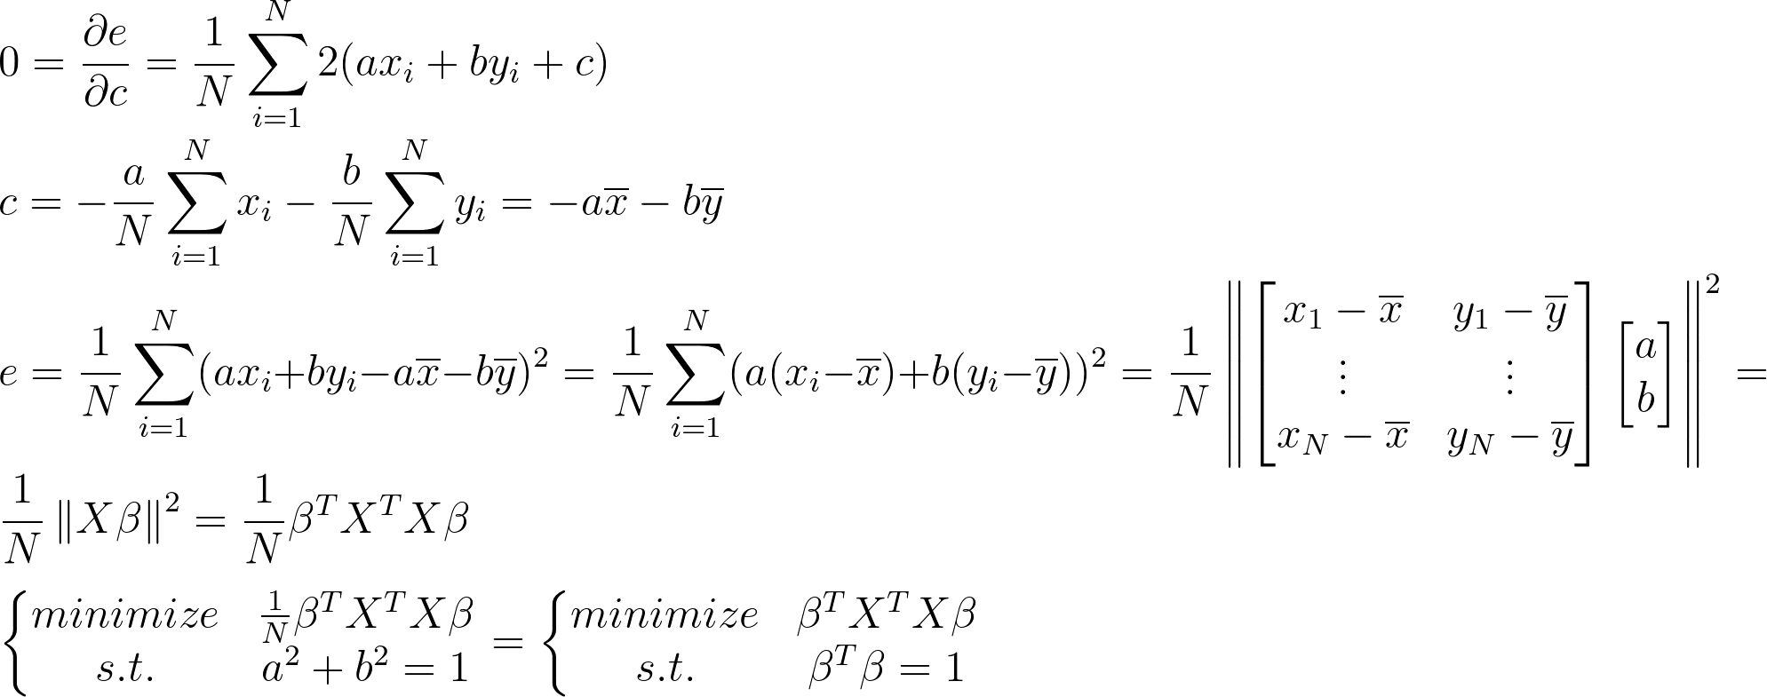
Line fitting- TLS- derivation
Notes:
\\
0=\frac{\partial e}{\partial c} = \frac{1}{N}\sum_{i=1}^{N}2(ax_i+by_i+c)\\
c=-\frac{a}{N}\sum_{i=1}^{N}x_i-\frac{b}{N}\sum_{i=1}^{N}y_i=-a\overline{x}-b\overline{y}\\
e=\frac{1}{N}\sum_{i=1}^{N} (ax_i+by_i-a\overline{x}-b\overline{y})^2=\frac{1}{N}\sum_{i=1}^{N} (a(x_i-\overline{x})+b(y_i-\overline{y}))^2=
\frac{1}{N}\left \|
\begin{bmatrix}
x_1-\overline{x}&y_1-\overline{y}\\
\vdots&\vdots\\
x_N-\overline{x}&y_N-\overline{y}
\end{bmatrix}
\begin{bmatrix}
a\\
b
\end{bmatrix}
\right \|^2=
\\
\frac{1}{N}\left \|
X\beta
\right \|^2= \frac{1}{N}\beta^TX^TX\beta\\
\\
\left\{\begin{matrix}
minimize & \frac{1}{N}\beta^TX^TX\beta\\
s.t. & a^2+b^2=1
\end{matrix}\right.
=
\left\{\begin{matrix}
minimize & \beta^TX^TX\beta\\
s.t. & \beta^T\beta=1
\end{matrix}\right.

Slide 50
Line fitting- TLS- derivation
Notes:
\\
0=\frac{\partial e}{\partial c} = \frac{1}{N}\sum_{i=1}^{N}2(ax_i+by_i+c)\\
c=-\frac{a}{N}\sum_{i=1}^{N}x_i-\frac{b}{N}\sum_{i=1}^{N}y_i=-a\overline{x}-b\overline{y}\\
e=\frac{1}{N}\sum_{i=1}^{N} (ax_i+by_i-a\overline{x}-b\overline{y})^2=\frac{1}{N}\sum_{i=1}^{N} (a(x_i-\overline{x})+b(y_i-\overline{y}))^2=
\frac{1}{N}\left \|
\begin{bmatrix}
x_1-\overline{x}&y_1-\overline{y}\\
\vdots&\vdots\\
x_N-\overline{x}&y_N-\overline{y}
\end{bmatrix}
\begin{bmatrix}
a\\
b
\end{bmatrix}
\right \|^2=
\\
\frac{1}{N}\left \|
X\beta
\right \|^2= \frac{1}{N}\beta^TX^TX\beta\\
\\
\left\{\begin{matrix}
minimize & \frac{1}{N}\beta^TX^TX\beta\\
s.t. & a^2+b^2=1
\end{matrix}\right.
=
\left\{\begin{matrix}
minimize & \beta^TX^TX\beta\\
s.t. & \beta^T\beta=1
\end{matrix}\right.

Slide 51
Line fitting- TLS- derivation
Notes:
\\
0=\frac{\partial e}{\partial c} = \frac{1}{N}\sum_{i=1}^{N}2(ax_i+by_i+c)\\
c=-\frac{a}{N}\sum_{i=1}^{N}x_i-\frac{b}{N}\sum_{i=1}^{N}y_i=-a\overline{x}-b\overline{y}\\
e=\frac{1}{N}\sum_{i=1}^{N} (ax_i+by_i-a\overline{x}-b\overline{y})^2=\frac{1}{N}\sum_{i=1}^{N} (a(x_i-\overline{x})+b(y_i-\overline{y}))^2=
\frac{1}{N}\left \|
\begin{bmatrix}
x_1-\overline{x}&y_1-\overline{y}\\
\vdots&\vdots\\
x_N-\overline{x}&y_N-\overline{y}
\end{bmatrix}
\begin{bmatrix}
a\\
b
\end{bmatrix}
\right \|^2=
\\
\frac{1}{N}\left \|
X\beta
\right \|^2= \frac{1}{N}\beta^TX^TX\beta\\
\\
\left\{\begin{matrix}
minimize & \frac{1}{N}\beta^TX^TX\beta\\
s.t. & a^2+b^2=1
\end{matrix}\right.
=
\left\{\begin{matrix}
minimize & \beta^TX^TX\beta\\
s.t. & \beta^T\beta=1
\end{matrix}\right.

Slide 52
Line fitting- TLS- derivation
Notes:
\\
0=\frac{\partial e}{\partial c} = \frac{1}{N}\sum_{i=1}^{N}2(ax_i+by_i+c)\\
c=-\frac{a}{N}\sum_{i=1}^{N}x_i-\frac{b}{N}\sum_{i=1}^{N}y_i=-a\overline{x}-b\overline{y}\\
e=\frac{1}{N}\sum_{i=1}^{N} (ax_i+by_i-a\overline{x}-b\overline{y})^2=\frac{1}{N}\sum_{i=1}^{N} (a(x_i-\overline{x})+b(y_i-\overline{y}))^2=
\frac{1}{N}\left \|
\begin{bmatrix}
x_1-\overline{x}&y_1-\overline{y}\\
\vdots&\vdots\\
x_N-\overline{x}&y_N-\overline{y}
\end{bmatrix}
\begin{bmatrix}
a\\
b
\end{bmatrix}
\right \|^2=
\\
\frac{1}{N}\left \|
X\beta
\right \|^2= \frac{1}{N}\beta^TX^TX\beta\\
\\
\left\{\begin{matrix}
minimize & \frac{1}{N}\beta^TX^TX\beta\\
s.t. & a^2+b^2=1
\end{matrix}\right.
=
\left\{\begin{matrix}
minimize & \beta^TX^TX\beta\\
s.t. & \beta^T\beta=1
\end{matrix}\right.

Slide 53
Line fitting- TLS- derivation
Notes:
\\
0=\frac{\partial e}{\partial c} = \frac{1}{N}\sum_{i=1}^{N}2(ax_i+by_i+c)\\
c=-\frac{a}{N}\sum_{i=1}^{N}x_i-\frac{b}{N}\sum_{i=1}^{N}y_i=-a\overline{x}-b\overline{y}\\
e=\frac{1}{N}\sum_{i=1}^{N} (ax_i+by_i-a\overline{x}-b\overline{y})^2=\frac{1}{N}\sum_{i=1}^{N} (a(x_i-\overline{x})+b(y_i-\overline{y}))^2=
\frac{1}{N}\left \|
\begin{bmatrix}
x_1-\overline{x}&y_1-\overline{y}\\
\vdots&\vdots\\
x_N-\overline{x}&y_N-\overline{y}
\end{bmatrix}
\begin{bmatrix}
a\\
b
\end{bmatrix}
\right \|^2=
\\
\frac{1}{N}\left \|
X\beta
\right \|^2= \frac{1}{N}\beta^TX^TX\beta\\
\\
\left\{\begin{matrix}
minimize & \frac{1}{N}\beta^TX^TX\beta\\
s.t. & a^2+b^2=1
\end{matrix}\right.
=
\left\{\begin{matrix}
minimize & \beta^TX^TX\beta\\
s.t. & \beta^T\beta=1
\end{matrix}\right.

Slide 54
Line fitting- TLS- derivation
Notes:
\\
0=\frac{\partial e}{\partial c} = \frac{1}{N}\sum_{i=1}^{N}2(ax_i+by_i+c)\\
c=-\frac{a}{N}\sum_{i=1}^{N}x_i-\frac{b}{N}\sum_{i=1}^{N}y_i=-a\overline{x}-b\overline{y}\\
e=\frac{1}{N}\sum_{i=1}^{N} (ax_i+by_i-a\overline{x}-b\overline{y})^2=\frac{1}{N}\sum_{i=1}^{N} (a(x_i-\overline{x})+b(y_i-\overline{y}))^2=
\frac{1}{N}\left \|
\begin{bmatrix}
x_1-\overline{x}&y_1-\overline{y}\\
\vdots&\vdots\\
x_N-\overline{x}&y_N-\overline{y}
\end{bmatrix}
\begin{bmatrix}
a\\
b
\end{bmatrix}
\right \|^2=
\\
\frac{1}{N}\left \|
X\beta
\right \|^2= \frac{1}{N}\beta^TX^TX\beta\\
\\
\left\{\begin{matrix}
minimize & \frac{1}{N}\beta^TX^TX\beta\\
s.t. & a^2+b^2=1
\end{matrix}\right.
=
\left\{\begin{matrix}
minimize & \beta^TX^TX\beta\\
s.t. & \beta^T\beta=1
\end{matrix}\right.

Slide 55
Line fitting- TLS- derivation
Notes:
\\
0=\frac{\partial e}{\partial c} = \frac{1}{N}\sum_{i=1}^{N}2(ax_i+by_i+c)\\
c=-\frac{a}{N}\sum_{i=1}^{N}x_i-\frac{b}{N}\sum_{i=1}^{N}y_i=-a\overline{x}-b\overline{y}\\
e=\frac{1}{N}\sum_{i=1}^{N} (ax_i+by_i-a\overline{x}-b\overline{y})^2=\frac{1}{N}\sum_{i=1}^{N} (a(x_i-\overline{x})+b(y_i-\overline{y}))^2=
\frac{1}{N}\left \|
\begin{bmatrix}
x_1-\overline{x}&y_1-\overline{y}\\
\vdots&\vdots\\
x_N-\overline{x}&y_N-\overline{y}
\end{bmatrix}
\begin{bmatrix}
a\\
b
\end{bmatrix}
\right \|^2=
\\
\frac{1}{N}\left \|
X\beta
\right \|^2= \frac{1}{N}\beta^TX^TX\beta\\
\\
\left\{\begin{matrix}
minimize & \frac{1}{N}\beta^TX^TX\beta\\
s.t. & a^2+b^2=1
\end{matrix}\right.
=
\left\{\begin{matrix}
minimize & \beta^TX^TX\beta\\
s.t. & \beta^T\beta=1
\end{matrix}\right.

Slide 56
Line fitting- TLS- derivation
Notes:
\\
0=\frac{\partial e}{\partial c} = \frac{1}{N}\sum_{i=1}^{N}2(ax_i+by_i+c)\\
c=-\frac{a}{N}\sum_{i=1}^{N}x_i-\frac{b}{N}\sum_{i=1}^{N}y_i=-a\overline{x}-b\overline{y}\\
e=\frac{1}{N}\sum_{i=1}^{N} (ax_i+by_i-a\overline{x}-b\overline{y})^2=\frac{1}{N}\sum_{i=1}^{N} (a(x_i-\overline{x})+b(y_i-\overline{y}))^2=
\frac{1}{N}\left \|
\begin{bmatrix}
x_1-\overline{x}&y_1-\overline{y}\\
\vdots&\vdots\\
x_N-\overline{x}&y_N-\overline{y}
\end{bmatrix}
\begin{bmatrix}
a\\
b
\end{bmatrix}
\right \|^2=
\\
\frac{1}{N}\left \|
X\beta
\right \|^2= \frac{1}{N}\beta^TX^TX\beta\\
\\
\left\{\begin{matrix}
minimize & \frac{1}{N}\beta^TX^TX\beta\\
s.t. & a^2+b^2=1
\end{matrix}\right.
=
\left\{\begin{matrix}
minimize & \beta^TX^TX\beta\\
s.t. & \beta^T\beta=1
\end{matrix}\right.

Slide 57
Line fitting- TLS- derivation
Notes:
\\
0=\frac{\partial e}{\partial c} = \frac{1}{N}\sum_{i=1}^{N}2(ax_i+by_i+c)\\
c=-\frac{a}{N}\sum_{i=1}^{N}x_i-\frac{b}{N}\sum_{i=1}^{N}y_i=-a\overline{x}-b\overline{y}\\
e=\frac{1}{N}\sum_{i=1}^{N} (ax_i+by_i-a\overline{x}-b\overline{y})^2=\frac{1}{N}\sum_{i=1}^{N} (a(x_i-\overline{x})+b(y_i-\overline{y}))^2=
\frac{1}{N}\left \|
\begin{bmatrix}
x_1-\overline{x}&y_1-\overline{y}\\
\vdots&\vdots\\
x_N-\overline{x}&y_N-\overline{y}
\end{bmatrix}
\begin{bmatrix}
a\\
b
\end{bmatrix}
\right \|^2=
\\
\frac{1}{N}\left \|
X\beta
\right \|^2= \frac{1}{N}\beta^TX^TX\beta\\
\\
\left\{\begin{matrix}
minimize & \frac{1}{N}\beta^TX^TX\beta\\
s.t. & a^2+b^2=1
\end{matrix}\right.
=
\left\{\begin{matrix}
minimize & \beta^TX^TX\beta\\
s.t. & \beta^T\beta=1
\end{matrix}\right.
or
\left\{\begin{matrix}
minimize & ||X\beta||^2\\
s.t. & ||\beta||^2=1
\end{matrix}\right.

Slide 58
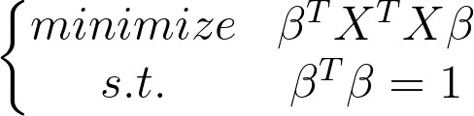
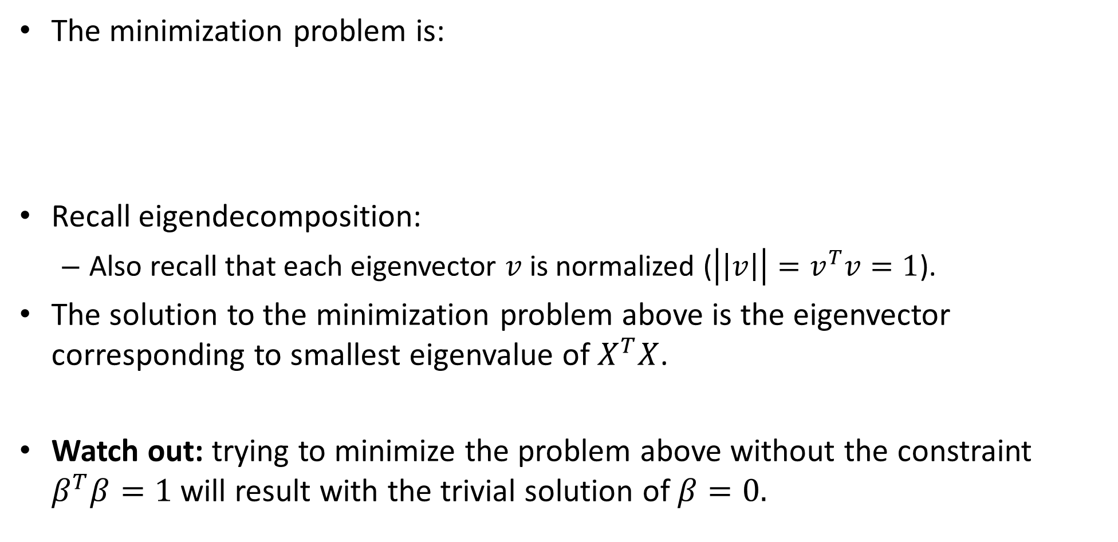
Line fitting- TLS -the minimization problem
The minimization problem is:
Recall eigendecomposition:
Also recall that each eigenvector $v$is normalized ($\left|\left|v\right|\right|=v^{T}v=1$).
The solution to the minimization problem above is the eigenvector corresponding to smallest eigenvalue of $X^{T}X$.
Watch out: trying to minimize the problem above without the constraint $β^{T}β=1$ will result with the trivial solution of $β=0.$
Notes:
Av = \lambda v \mapsto v^TAv = \lambda

Slide 59
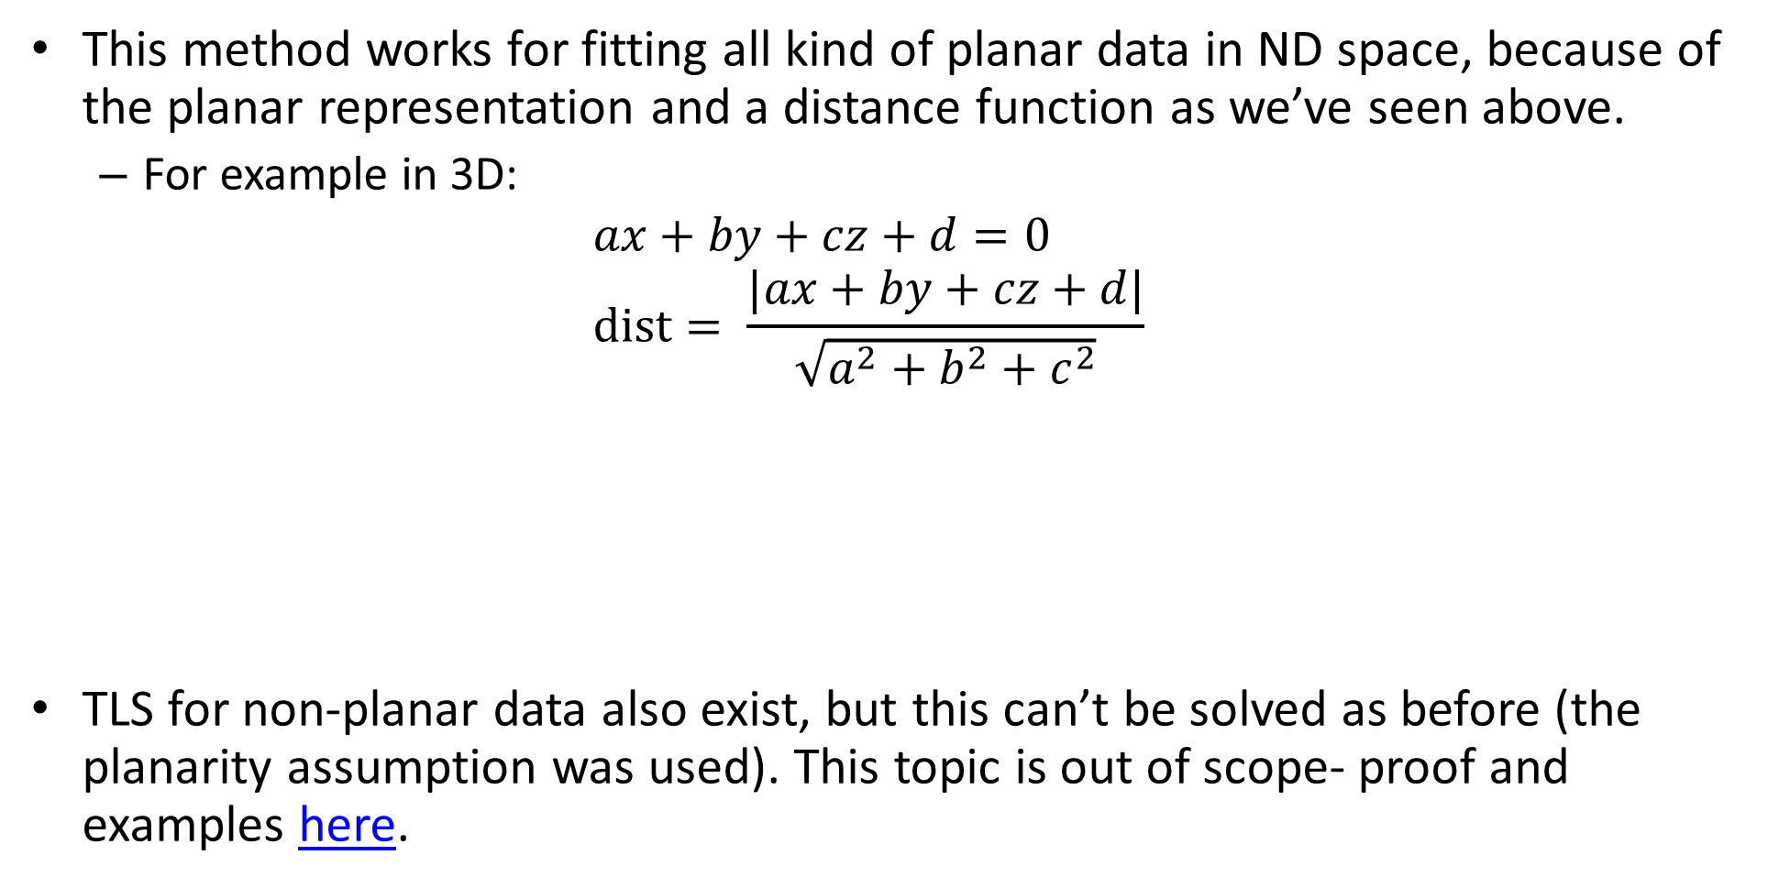
The planarity assumption
This method works for fitting all kind of planar data in ND space, because of the planar representation and a distance function as we’ve seen above.
For example in 3D:
$$ax+by+cz+d=0 \\ dist= \frac{|ax+by+cz+d|}{\sqrt{a^{2}+b^{2}+c^{2}}}$$
TLS for non-planar data also exist, but this can’t be solved as before (the planarity assumption was used). This topic is out of scope- proof and examples here.

Slide 60
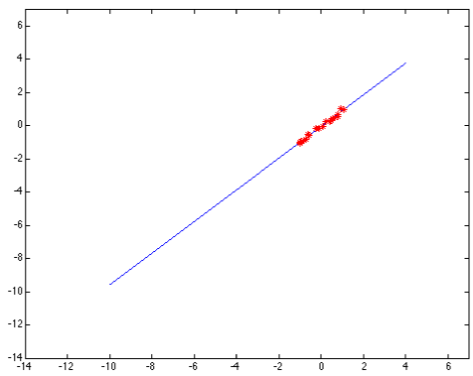
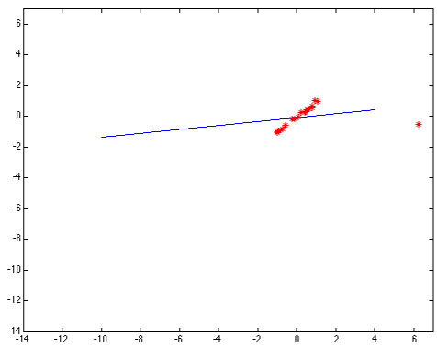
Problem 2: fitting with outliers datapoints
Outlier: a data point that differs significantly from other observations. [Wikipedia]
Least-squares error fit
Squared error heavily penalizes outliers

Slide 61
Problem 2: fitting with outliers datapoints
One possible solution: MAE (again)- for less penalization on outliers.
A better solution: removing the outliers! Possible algorithm to use: RANSAC

Slide 62
TOC
Least squares
Total least squares
RANSAC

Slide 63
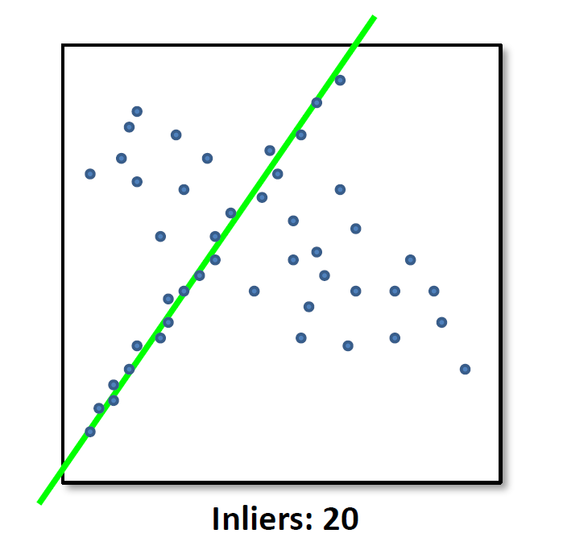
RANSAC
Random sample consensus (RANSAC) is an iterative method to estimate parameters of a mathematical model from a set of observed data that contains outliers. [Wikipedia]

Slide 64
RANSAC algorithm
While searching for best model fit:
Select a random subset of the original data.
Fit a model to the data subset.
find inliers that fit the given model.
if number_inliers is bigger than the old best model number_inliers:
Save as best model

Slide 65
RANSAC algorithm - step by step - 1
Select a random subset of the original data.
The number of samples in the subset is the smallest needed to determine the model parameters (== number of unknow variables).
Examples:
For line fit- only 2 datapoints.
For parabola fit- 3 datapoints.

Slide 66
RANSAC algorithm - step by step - 2
Fit a model to the data subset.
Can be done using a chosen algorithm (for example LS).

Slide 67
RANSAC algorithm - step by step - 3
find inliers that fit the given model.
Test all dataset against the fitted model. Points that fit the estimated model well, according to some chosen loss function, are considered as part of the consensus set. This points are called inliers.
A possible loss function is MSE of the distances (same as TLS).
Choose a threshold for the error: below this TH the datapoint will be consider as an inlier.
TH

Slide 68
RANSAC algorithm - step by step - 4
if number_inliers is bigger than the old best model number_inliers:
Save as best model
Trivial…
An improvement to the final step can be iteratively re-fitting the model with all inliers to find a better describing model.

Slide 69
RANSAC algorithm - step by step - 0
While searching for best model fit:
How do we know when to stop? How much we need to iterate before getting the best model?
Let’s look at a possible statistical model for this question.

Slide 70
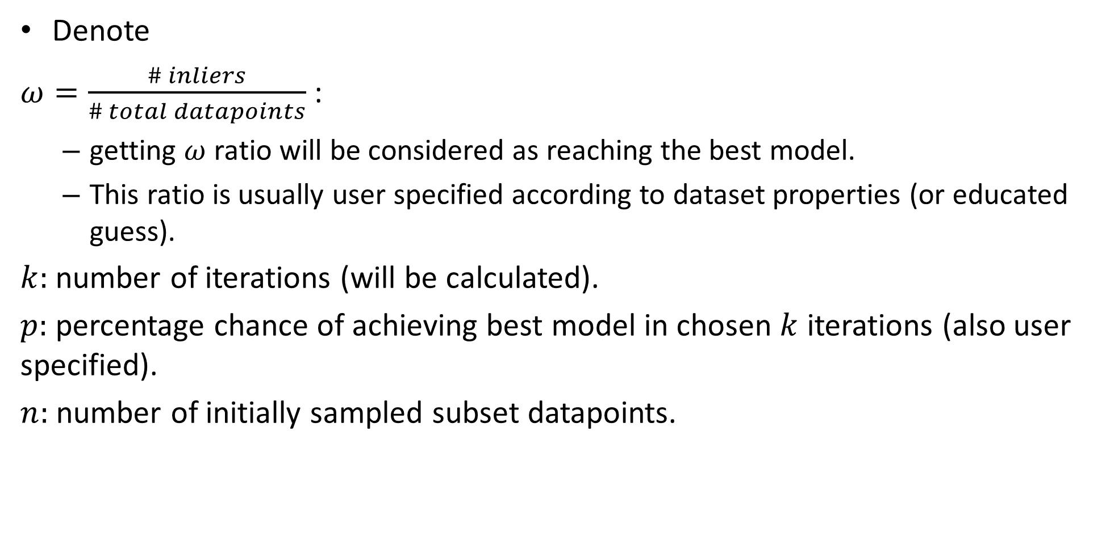
RANSAC convergence
Denote
$ω=\frac{\# inliers}{\# total datapoints}$ :
getting $ω$ ratio will be considered as reaching the best model.
This ratio is usually user specified according to dataset properties (or educated guess).
$k:$ number of iterations (will be calculated).
$p:$ percentage chance of achieving best model in chosen $k$ iterations (also user specified).
$n:$ number of initially sampled subset datapoints.

Slide 71
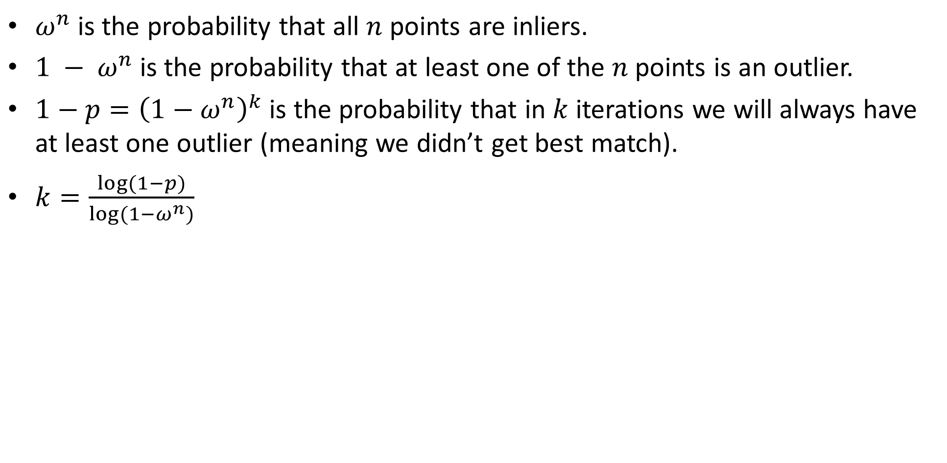
RANSAC convergence
$ω^{n}$is the probability that all $n$ points are inliers.
$1 − ω^{n}$is the probability that at least one of the $n$points is an outlier.
$1−p={\left(1−ω^{n}\right)}^{k}$ is the probability that in $k$ iterations we will always have at least one outlier (meaning we didn’t get best match).
$k=\frac{log⁡(1−p)}{log⁡(1−ω^{n})}$

